Slide 1
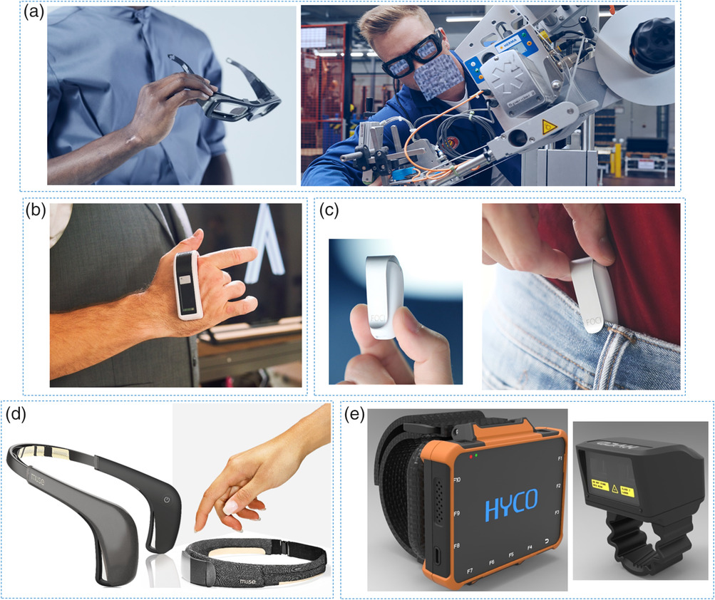
Trends in Workplace Wearable Technologies and Connected‐Worker Solutions for Next‐Generation Occupational Safety, Health, and Productivity
Figure 3: Examples of wearables for occupational productivity monitoring. a) ViewPoint Systems VPS 16 smart glasses have stereoscopic cameras that track spatial vision and have live streaming capabilities for mixed reality applications. b) Tactigon Skin uses sensors to detect hand gestures and AI to remotely interact with digital machines. c) The Tinylogic Foci clip-on device monitors the breathing patterns to estimate cognitive state of mind and suggests ways to avoid distraction at work. d) Muse 2 and Muse S headbands measure brain electrical activity and provide real-time feedback on body performance and mental focus. e) Hyco's W562 smartwatch enables hands-free barcode scanning for goods tracking and asset management.
Advanced Intelligent Systems, Volume: 4, Issue: 1, First published: 23 September 2021, DOI: (10.1002/aisy.202100099)
Notes:
Examples of wearables for occupational productivity monitoring. a) ViewPoint Systems VPS 16 smart glasses have stereoscopic cameras that track spatial vision and have live streaming capabilities for mixed reality applications. b) Tactigon Skin uses sensors to detect hand gestures and AI to remotely interact with digital machines. c) The Tinylogic Foci clip‐on device monitors the breathing patterns to estimate cognitive state of mind and suggests ways to avoid distraction at work. d) Muse 2 and Muse S headbands measure brain electrical activity and provide real‐time feedback on body performance and mental focus. e) Hyco's W562 smartwatch enables hands‐free barcode scanning for goods tracking and asset management. a) Reproduced with permission.[231] Copyright 2021, ViewPoint System; b) Reproduced with permisison.[107] Copyright 2021, The Tactigon; c) Reproduced with permission.[121] Copyright 2021, Tinylogic Foci; d) Reproduced with permisison.[114] Copyright 2021, Muse; and e) Reproduced with permission.[86] Copyright 2021, Hyco.
IF THIS IMAGE HAS BEEN PROVIDED BY OR IS OWNED BY A THIRD PARTY, AS INDICATED IN THE CAPTION LINE, THEN FURTHER PERMISSION MAY BE NEEDED BEFORE ANY FURTHER USE. PLEASE CONTACT WILEY'S PERMISSIONS DEPARTMENT ON PERMISSIONS@WILEY.COM OR USE THE RIGHTSLINK SERVICE BY CLICKING ON THE 'REQUEST PERMISSIONS' LINK ACCOMPANYING THIS ARTICLE. WILEY OR AUTHOR OWNED IMAGES MAY BE USED FOR NON-COMMERCIAL PURPOSES, SUBJECT TO PROPER CITATION OF THE ARTICLE, AUTHOR, AND PUBLISHER.

